Slide 1




TransConnect
TransConnect:
Revolutionizing Public
Transportation
in Rwanda
Presented by:
[Name]
Date: [Date]
Innovating public
transport with
real-time geolocation,
AI, and NFC
integration

Slide 2
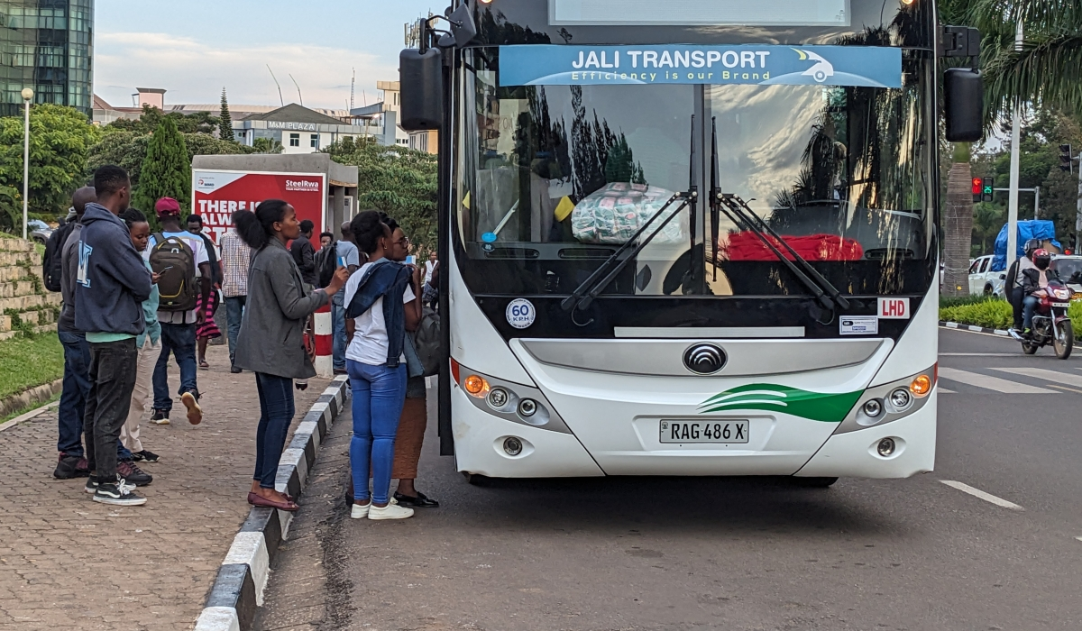












Course Outline
Problem Statement
Online Bus Booking
AI Crowd Management
Our Solution
Passenger Monitoring
Target Audience
Key Features
Speed Tracking
Implementation Plan
Real-Time Geolocation
NFC Payment Integration
Financial Model

Slide 3
Problem Statement
Challenges in Public Transportation:
Uncertainty in bus availability and schedules
Overcrowding at main stations and bus stops
Inefficient manual booking systems
Lack of real-time passenger and speed
monitoring
Limited integration of technology
for payments and operations

Slide 4

Our Solution
Introducing TransConnect:
A comprehensive digital platform
addressing public transportation
challenges in Rwanda
Features include bus route availability,
booking system, passenger monitoring,
speed tracking, NFC-based payments,
and AI-based crowd management

Slide 5

Key Features
Core Functionalities of TransConnect:
Bus Booking System: Book seats online via app
Speed Tracking: Monitor bus speed for safety
NFC Payments: Seamless payment with mobile devices
Real-Time Geolocation: Track buses in real time
Passenger Monitoring: Use sensors to count passengers
onboard
AI Management: Optimize boarding processes at stations …

Slide 6


Real-Time
Geolocation
Benefits:
Accurate bus location updates
Reduced waiting times for passengers
Improved route management for operators
Enhanced service reliability

Slide 7

Online
Bus Booking
Features:
Easy seat reservation through a mobile app
View seat availability in real-time
Avoid overcrowding and ensure convenience

Slide 8

Passenger
Monitoring
Sensor-Based System:
Count passengers onboard in real-time
Display available capacity to passengers
Improve boarding and operational efficiency

Slide 9

Speed
Tracking
Geolocation-Based Monitoring:
Ensure buses adhere to speed limits
Enhance passenger safety
Monitor driver behavior for better compliance

Slide 10

NFC Payment
Integration
Seamless Transactions:
Use mobile devices for quick, contactless
payments
Eliminate the need for cash handling
Integrate with existing mobile payment systems

Slide 11

AI Crowd
Management
AI-Driven Optimization:
Balance passengers between main stations and bus stops
Predict peak times and adjust bus availability
Reduce overcrowding and enhance commuter experience

Slide 12
Target Audience
Who Benefits from TransConnect?
Commuters: Convenience, reliability,
and safety
Transport Operators: Streamlined
operations and revenue growth
Government & Authorities: Improved
urban mobility and reduced traffic
congestion

Slide 13

Implementation Plan
Phase-Wise Deployment:
Full-Scale Deployment (12 months)
Pilot Testing in Key Cities (6
months)
Prototype Development (3–6
months)
Continuous Upgrades and Support

Slide 14

Financial Model
Revenue Streams:
Subscription fees for operators
Transaction fees for NFC payments
Advertising opportunities on the
platform

Slide 15

Expected Impact
Transforming Public Transportation:
Reduce waiting times by 30%
Increase passenger satisfaction by
50%
Improve safety and efficiency in the
public transport sector
Encourage sustainable urban mobility

Slide 16

Our Platforms
Contact Us:
Thank You!
email: musazapatrick369@gmail.com
Phone: +250) 798 219 444
Web: TransConnect Rwanda
App: TransConnect Rwanda
Facebook: TransConnect Rwanda
X: TransConnect Rwanda
Instagram: TransConnect Rwanda

Slide 17

Join Us in Revolutionizing
Transport in Rwanda!
Together, we can make
commuting smarter, safer,
and more efficient
Thank You!

